Slide 1
Linear Models
CSN-382

Slide 2

Linear Classifier
Linear classifiers classify data into labels based on a linear combination of input features. Therefore, these classifiers separate data using a line or plane or a hyperplane (a plane in more than 2 dimensions).
They can only be used to classify data that is linearly separable.
They can be modified to classify non-linearly separable data (using Kernel methods).
We will discuss 3 major algorithms in linear binary classification -
Perceptron
Logistic Regression
SVM
Will see Perceptron, Logistic Regression, SVM in detail later

Slide 3
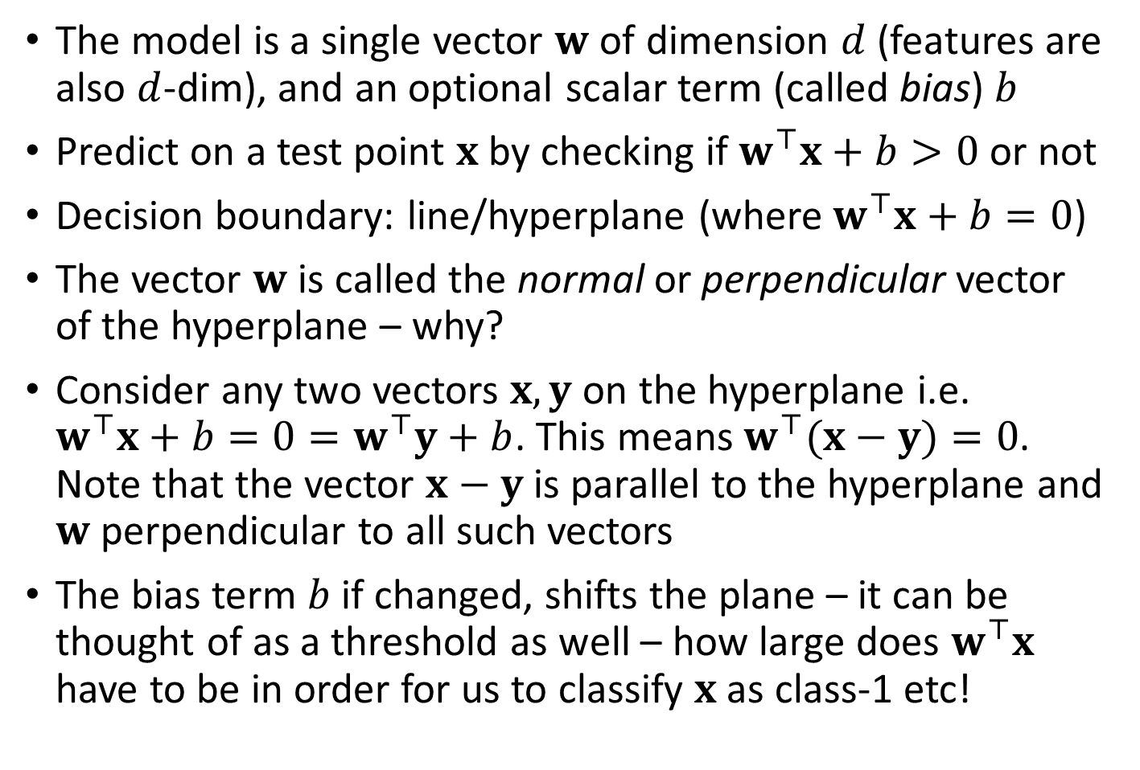

Linear/hyperplane Classifiers
The model is a single vector $w$ of dimension $d$ (features are also $d$-dim), and an optional scalar term (called bias) $b$
Predict on a test point $x$ by checking if $w^{⊤}x+b>0$ or not
Decision boundary: line/hyperplane (where $w^{⊤}x+b=0$)
The vector $w$ is called the normal or perpendicular vector of the hyperplane – why?
Consider any two vectors $x,y$ on the hyperplane i.e. $w^{⊤}x+b=0=w^{⊤}y+b$. This means $w^{⊤}(x−y)=0$. Note that the vector $x−y$ is parallel to the hyperplane and $w$ perpendicular to all such vectors
The bias term $b$ if changed, shifts the plane – it can be thought of as a threshold as well – how large does $w^{⊤}x$ have to be in order for us to classify $x$ as class-1 etc!
$$w$$

Slide 4

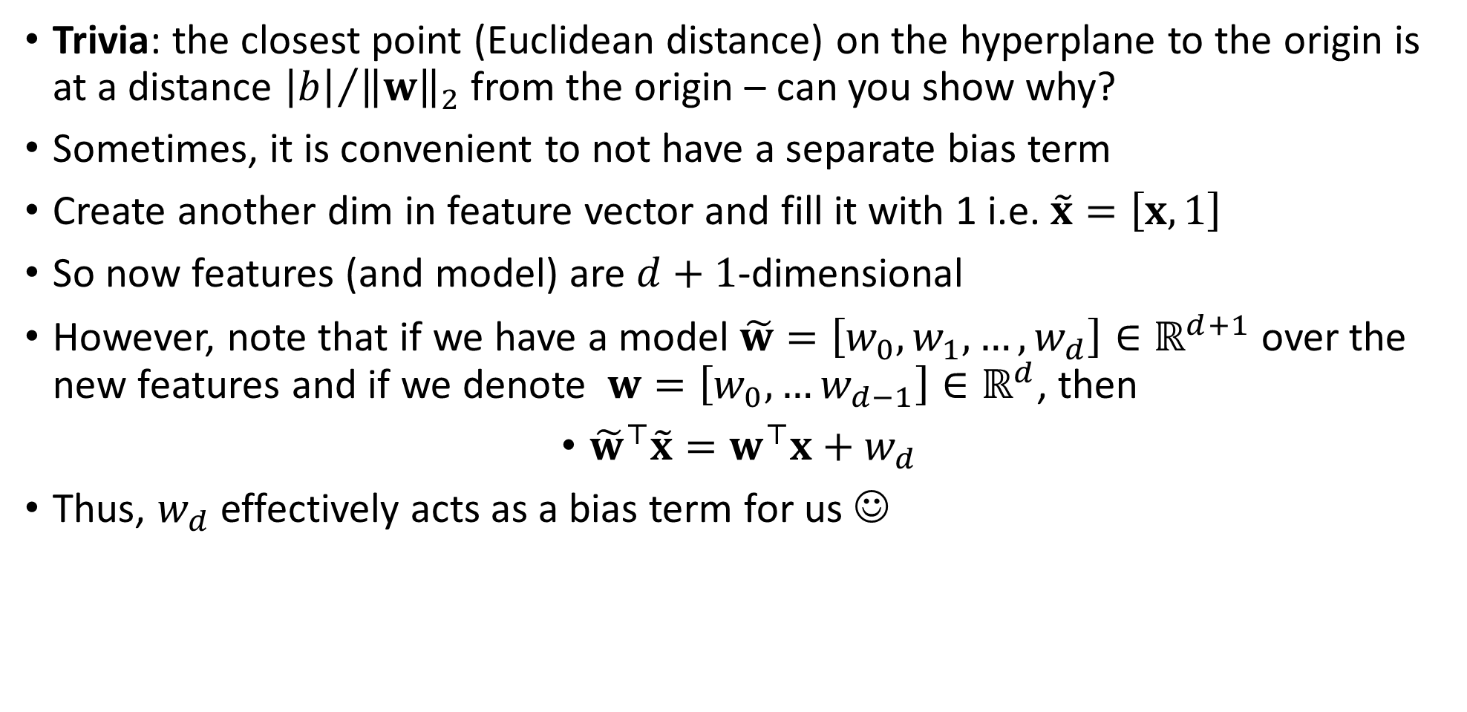
To $b$ or not to $b$ – that is the question!
Trivia: the closest point (Euclidean distance) on the hyperplane to the origin is at a distance ${\left|b\right|}/{{\left\|w\right\|}_{2}}$ from the origin – can you show why?
Sometimes, it is convenient to not have a separate bias term
Create another dim in feature vector and fill it with 1 i.e. $\tilde{x}=\left[x,1\right]$
So now features (and model) are $d+1$-dimensional
However, note that if we have a model $\tilde{w}=\left[w_{0},w_{1},…,w_{d}\right]∈ℝ^{d+1}$ over the new features and if we denote $w=\left[w_{0},…w_{d−1}\right]∈ℝ^{d}$, then
${\tilde{w}}^{⊤}\tilde{x}=w^{⊤}x+w_{d}$
Thus, $w_{d}$ effectively acts as a bias term for us ☺

Slide 5
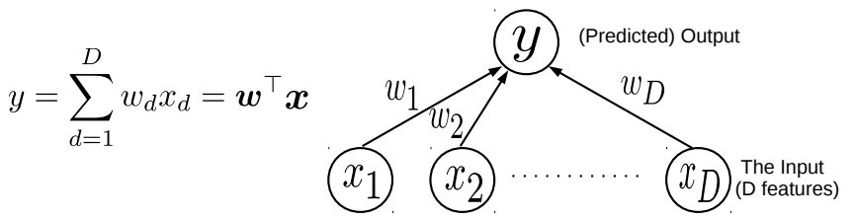

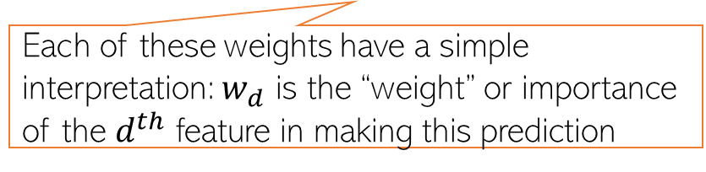
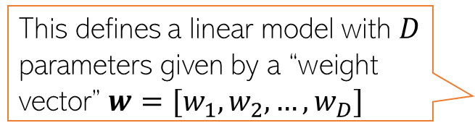
Linear Models
5
Consider learning to map an input $x∈ℝ^{D}$ to the corresponding (say real-valued) output $y$
Assume the output to be a linear weighted combination of the $D$ input features
This simple model can be used for Linear Regression
This simple model can also be used as a “building block” for more complex models
Even classification (binary/multiclass/multi-output/multi-label) and various other ML/deep learning models
Even unsupervised learning problems (e.g., dimensionality reduction models)
This defines a linear model with $D$ parameters given by a “weight vector” $w=[w_{1},w_{2},…,w_{D}]$
Each of these weights have a simple interpretation: $w_{d}$ is the “weight” or importance of the $d^{th}$ feature in making this prediction
The “optimal” weights are unknown and have to be learned by solving an optimization problem, using some training data

Slide 6
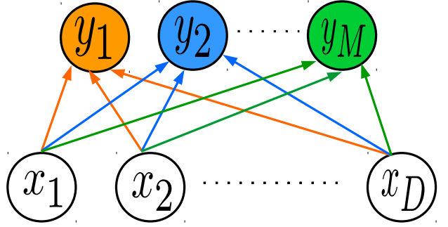

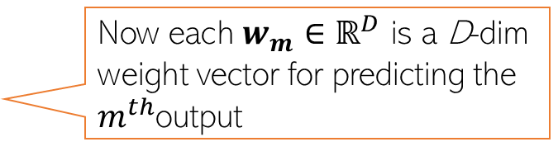



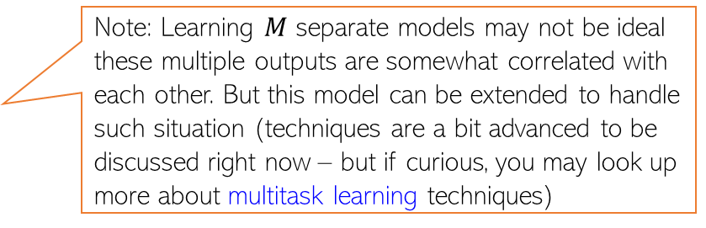



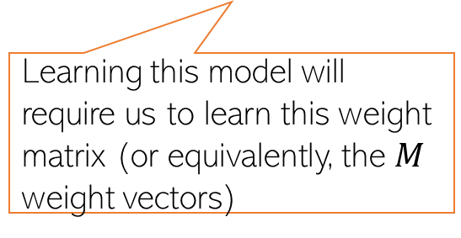


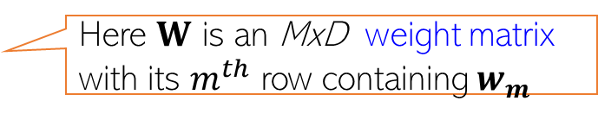
Simple Linear Models as Building Blocks
6
In some regression problems, each output itself is a real-valued vector $y∈ℝ^{M}$
Example: Given a full body image of a person, predict height, weight, hand size, and leg size ($M=4)$
Such problems are commonly known as multi-output regression
We can assume a separate linear model for each of the $M$ outputs $y_{m }(m=1,2,…,M)$
Now each $w_{m}$ $∈ℝ^{D}$ is a D-dim weight vector for predicting the $m^{th}$output
$$y_{m}= w_{m}^{⊤}x$$
$$y=Wx$$
Here $W$ is an MxD weight matrix with its $m^{th}$ row containing $w_{m}$
$$w_{1}^{⊤}$$
Note: Learning $M$ separate models may not be ideal these multiple outputs are somewhat correlated with each other. But this model can be extended to handle such situation (techniques are a bit advanced to be discussed right now – but if curious, you may look up more about multitask learning techniques)
Learning this model will require us to learn this weight matrix (or equivalently, the $M$ weight vectors)
$$w_{2}^{⊤}$$
$$w_{M}^{⊤}$$
$$x$$
$$y$$
$$W$$

Slide 7
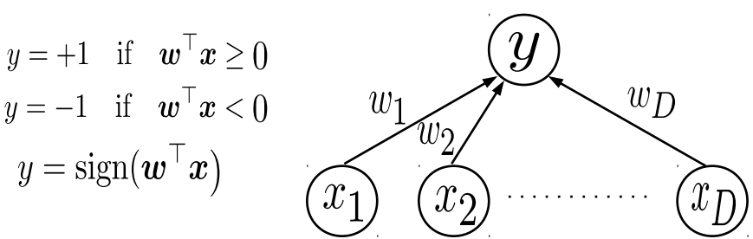

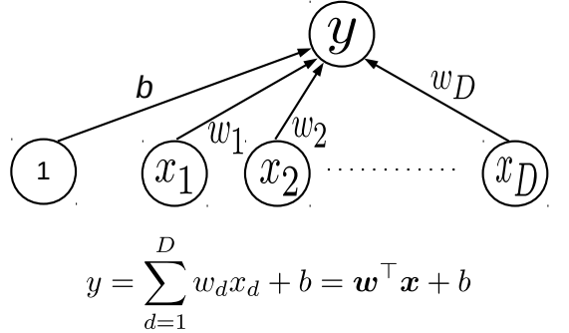
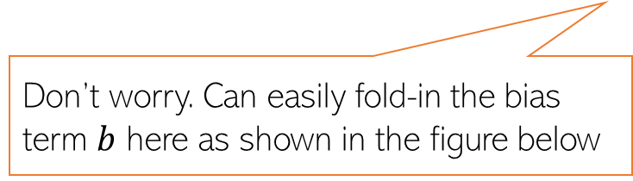

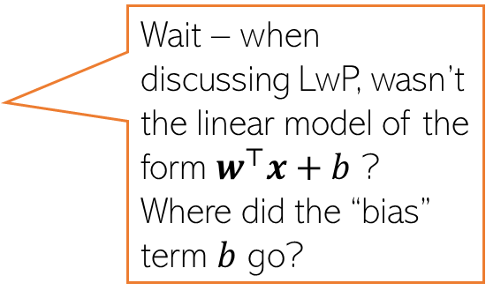
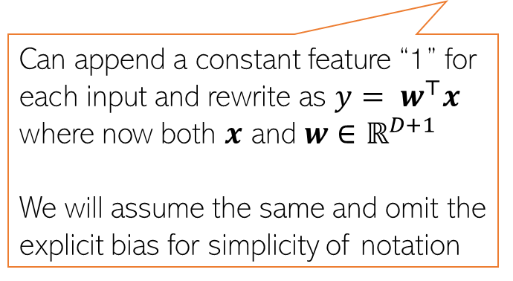
Simple Linear Models as Building Blocks
7
A linear model $y= w^{⊤}x$ can also be used in classification problems
For binary classfn, can treat $w^{⊤}x$ as the “score” of input $x$ and threshold to get binary label
Recall that the LwP model can also be seen as a linear model (although it wasn’t formulated like this)
Don’t worry. Can easily fold-in the bias term $b$ here as shown in the figure below
Wait – when discussing LwP, wasn’t the linear model of the form $w^{⊤}x+b$ ? Where did the “bias” term $b$ go?
Can append a constant feature “1” for each input and rewrite as $y= w^{⊤}x$ where now both $x$ and $w∈$ $ℝ^{D+1}$
We will assume the same and omit the explicit bias for simplicity of notation

Slide 8

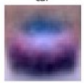
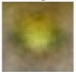
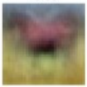
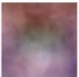
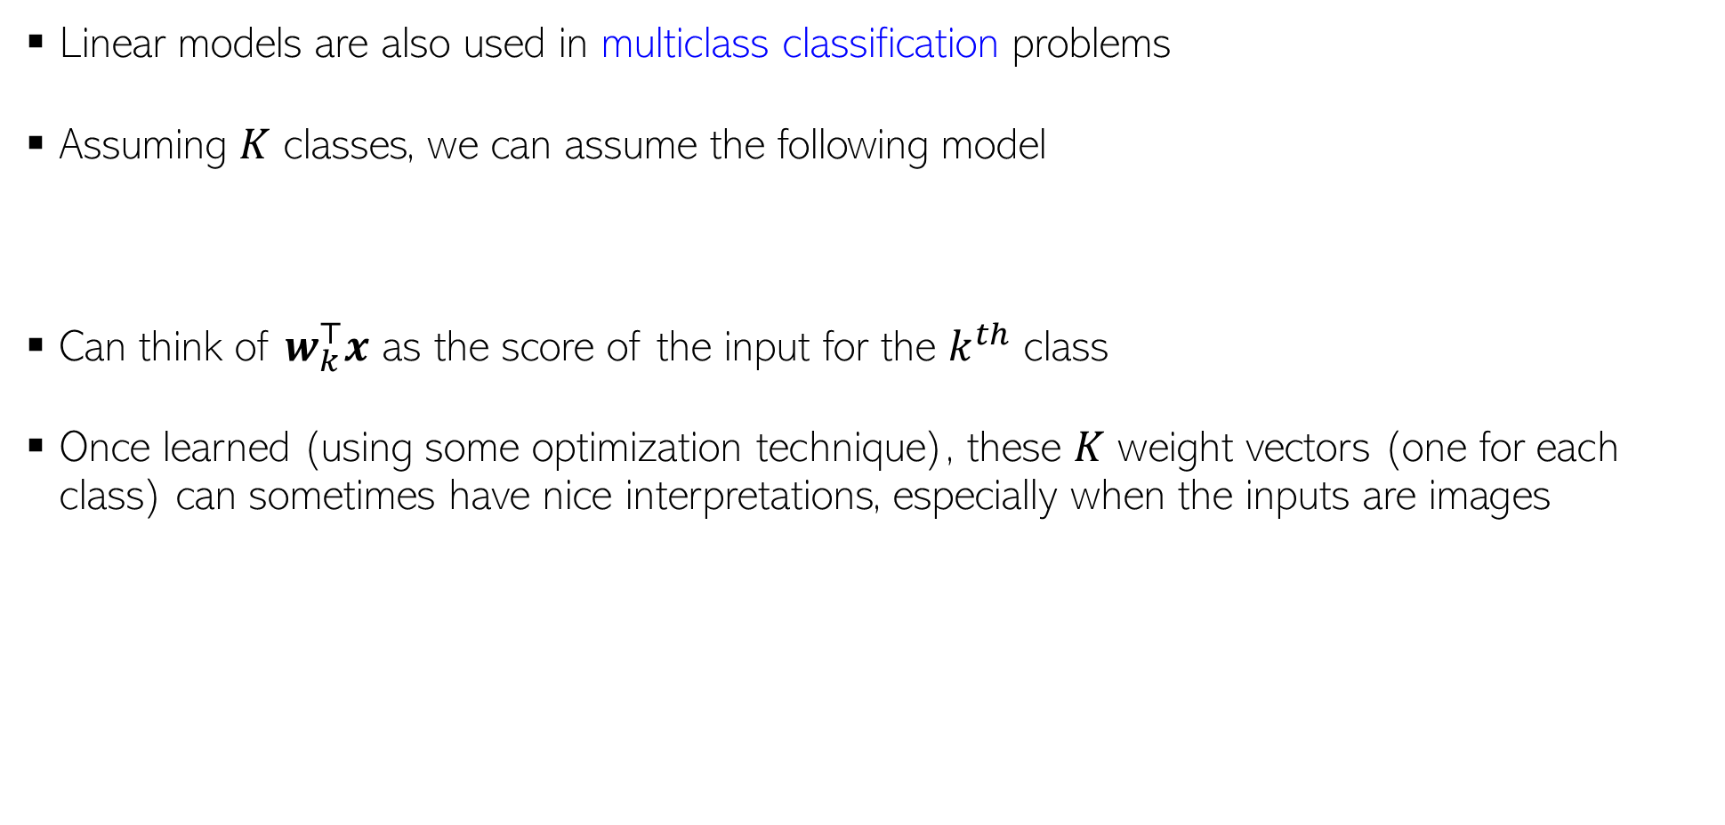





Simple Linear Models as Building Blocks
8
Linear models are also used in multiclass classification problems
Assuming $K$ classes, we can assume the following model
Can think of $w_{k}^{⊤}x$ as the score of the input for the $k^{th}$ class
Once learned (using some optimization technique), these $K$ weight vectors (one for each class) can sometimes have nice interpretations, especially when the inputs are images
$$y= {argmax}_{k∈\{1,2,…,K\}} w_{k}^{⊤}x$$
The learned weight vectors of each of the 4 classes visualized as images – they kind of look like a “template” of what the images from that class should look like
These images sort of look like class prototypes if I were using LwP ☺
$$w_{car}$$
$$w_{frog}$$
$$w_{horse}$$
$$w_{cat}$$
Yeah, “sort of”. ☺
No wonder why LwP (with Euclidean distances) acts like a linear model. ☺
That’s why the dot product of each of these weight vectors with an image from the correct class will be expected to be the largest

Slide 9
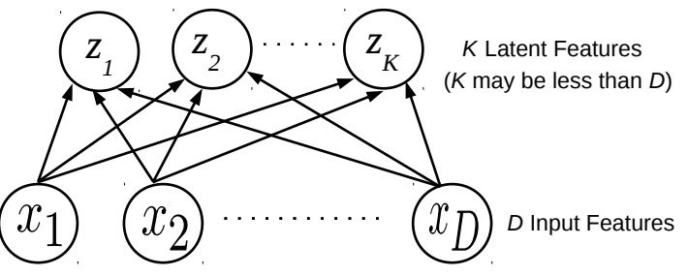
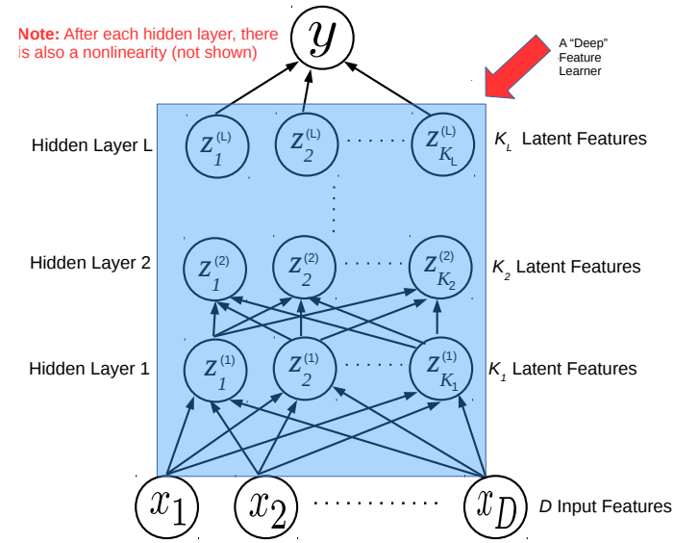
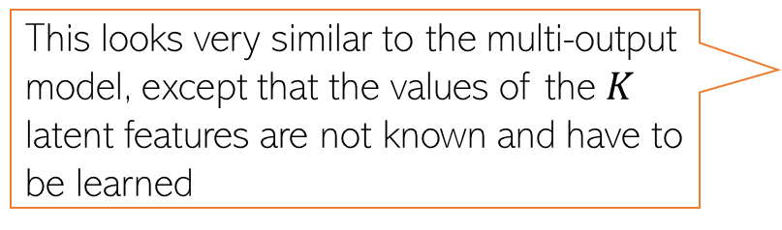
Simple Linear Models as Building Blocks
9
Linear models are building blocks for dimensionality reduction methods like PCA
Linear models are building blocks for even deep learning model (each layer is like a multi-output linear model, followed by a nonlinearity)
This looks very similar to the multi-output model, except that the values of the $K$ latent features are not known and have to be learned
In a deep learning model, each layer learns a latent feature representation of the inputs using a model like a multi-output linear model, followed by a nonlinearity
The last (output) layer can have one or more outputs
More on this when we discuss deep learning later

Slide 10
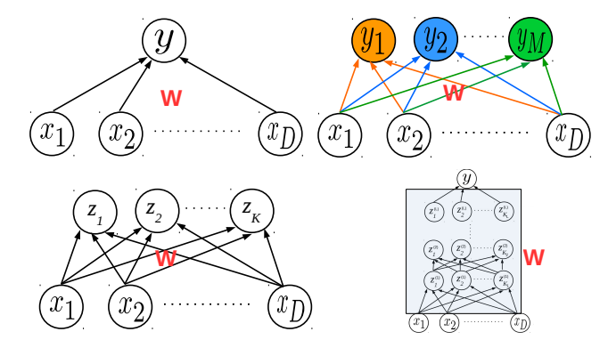
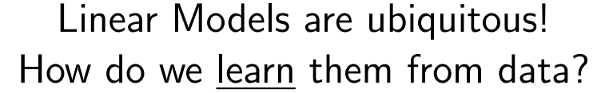
Learning Linear Models
10

